Slide 1
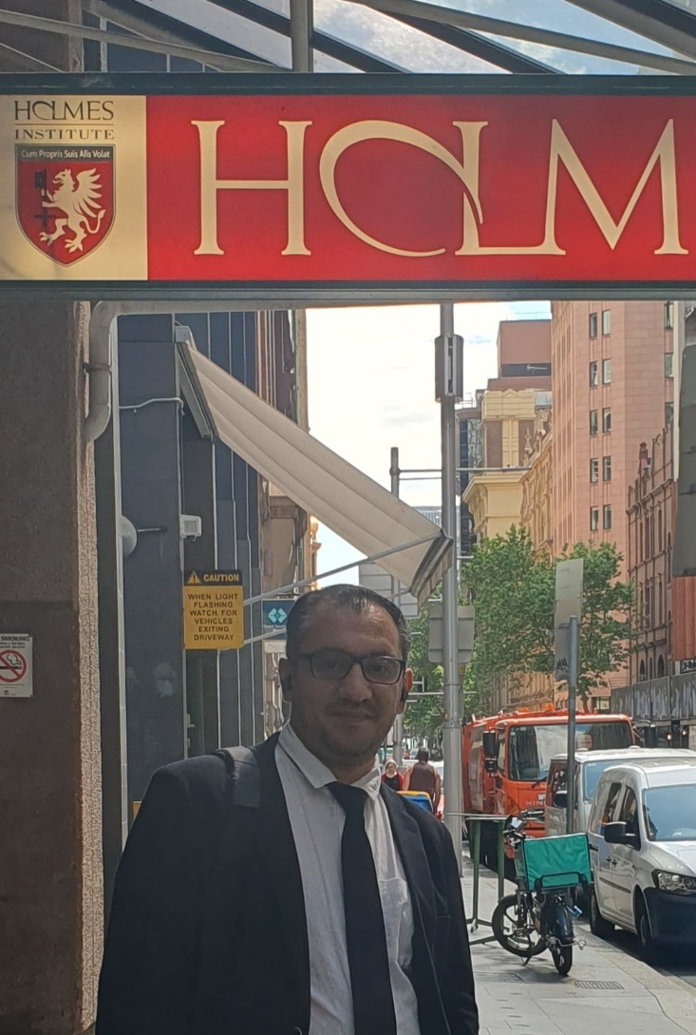

HS1021: Web Design
Weeks 10 – 11 Tutorial
Dr. Farshid Keivanian

Slide 2

Week 10 and 11 – Web Design – Sydney Campus
Instructions for Completing Week-10 lab (Project 1 and Challenge 1)
Instructions for Completing Week-11 lab (Project 2 and Challenge 2)
Lecturer/Tutor: Dr. Farshid Keivanian

Slide 3
Instructions for Completing the Week 10 tutorial
Let's work through Project 1: Adding Audio to a Webpage step by step. Here are the instructions:
Open apply10.html in your text editor, review the page, add a title, modify the comment at the top of the page to include your name and today’s date, and replace “Student’s Name” with your name in the footer element.

Slide 4
Instructions for Completing the Week 10 tutorial
Insert an audio element below the figure element.
Set the audio element to play automatically and to repeat continuously.
Insert three source elements within the audio element and use the three audio files on Bb.

Slide 5
Instructions for Completing the Week 10 tutorial
5. Include a paragraph element within the audio element that advises legacy browser users that their browser does not support the audio element.
6. Save all of your changes and open the apply10.html in your browser.
7. Validate your HTML document using the W3C validator found at validator.w3.org and fix any errors that are identified.
8. Submit the files in a format specified by your instructor.

Slide 6
Instructions for Completing the Week 10 tutorial
Beach Sunset with Audio.
This is indicated by the title element <title>Beach Sunset with Audio</title> within the head section, suggesting that the webpage is designed to showcase a relaxing beach sunset image accompanied by audio, creating a tranquil experience for the viewer.

Slide 7
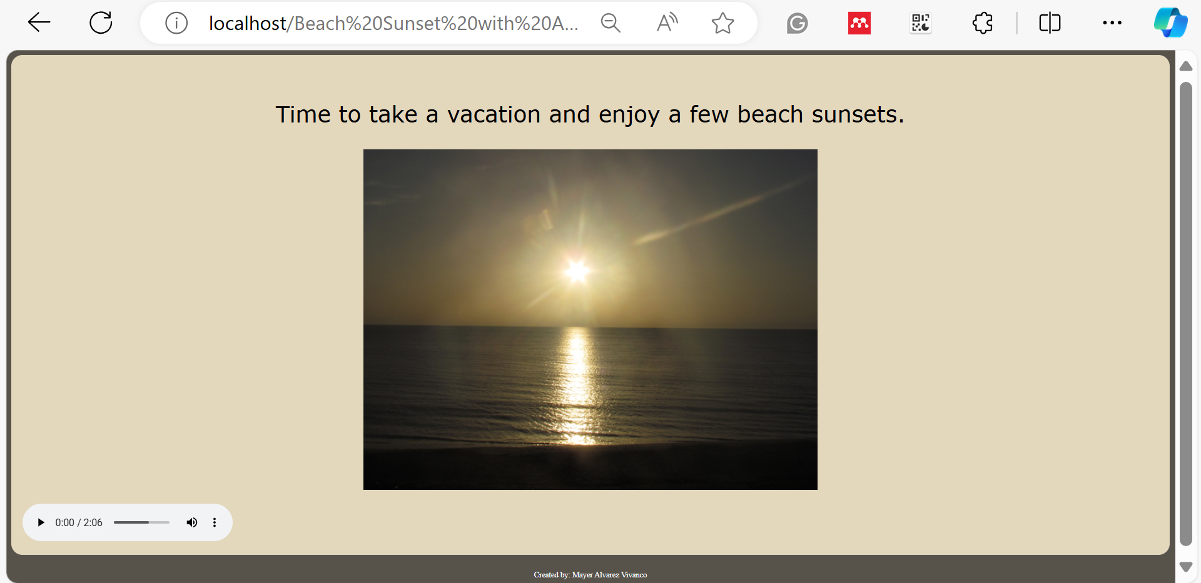
Instructions for Completing the Week 10 tutorial

Slide 8
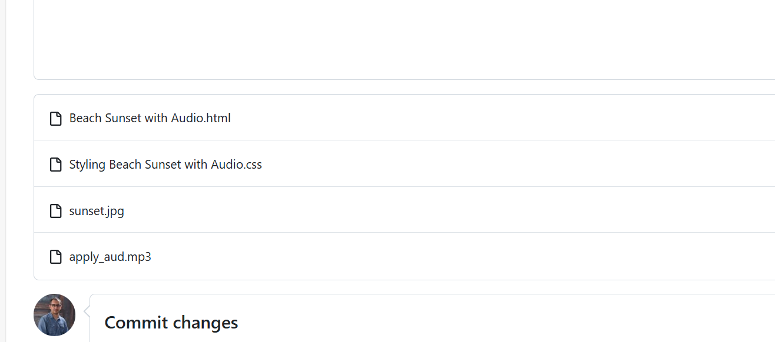
Instructions for Completing the Week 10 tutorial

Slide 9
Instructions for Completing the Week 10 tutorial
Challenge 1: Exploring Multimedia File Formats and Plug-ins
Why were plug-ins created and how are they used by a browser?
Plug-ins were created to extend the functionality of web browsers, enabling them to handle multimedia content such as video, audio, and animations that were not supported by the browser natively.
Why are plug-ins losing their popularity?
Plug-ins are losing popularity due to security vulnerabilities, performance issues, and the advent of HTML5, which natively supports multimedia content without the need for additional plug-ins.

Slide 10
Instructions for Completing the Week 10 tutorial
3. What plug-ins are installed on your desktop browser?
This can be checked in your browser's settings or extensions section. Common plug-ins include Adobe Flash Player, Microsoft Silverlight, and various media codecs.
4. What is Microsoft Silverlight?
Microsoft Silverlight is a deprecated application framework used for writing and running rich Internet applications, similar to Adobe Flash. It was used to stream multimedia content and run rich web applications.

Slide 11
Instructions for Completing the Week 10 tutorial
5. How to update the Adobe Flash Player plugin for your browser?
Adobe Flash Player updates are managed by the browser itself or the operating system. For manual updates, you can visit the Adobe Flash Player download page and follow the instructions provided.

Slide 12
Instructions for Completing the Week 11 tutorial
Let's work through Project 2: Adding Meta Tags and Publishing a Webpage step by step. Here are the instructions:
Create a new HTML file named apply11.html. Include a comment with your name and today’s date.
Include all necessary HTML5 elements for a webpage.
Create a title for the page and use Credit as the webpage title.
Insert a description meta tag with a content attribute and use This website provides helpful information about how to build good credit. as the value.

Slide 13
Instructions for Completing the Week 11 tutorial
5. Create a header element.
6. Create an h1 element within the header element and include the text How to Build Good Credit as the heading text.
7. Create a main element.
8. Research ways to build good credit and summarize your findings within a paragraph element within the main element.

Slide 14
Instructions for Completing the Week 11 tutorial
9. Create an unordered list of at least three steps one should take to build credit. Place the unordered list below the paragraph element, but within the main element.
10. Create a footer element that contains your name.
11. Save your changes.

Slide 15
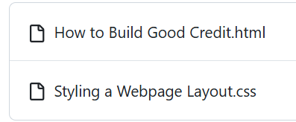
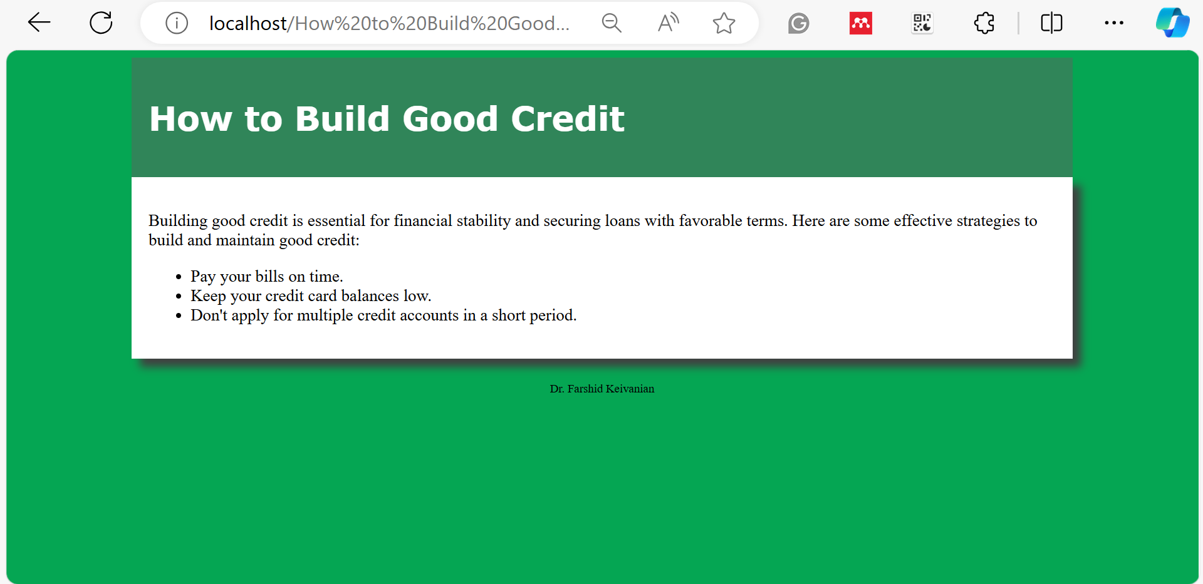
Instructions for Completing the Week 11 tutorial
HTML Code for Project 2 (apply11.html) with (applystyles11.css)

Slide 16
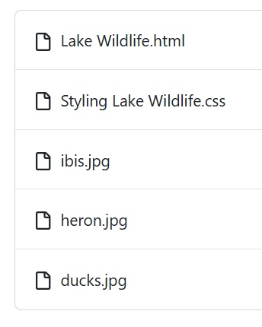
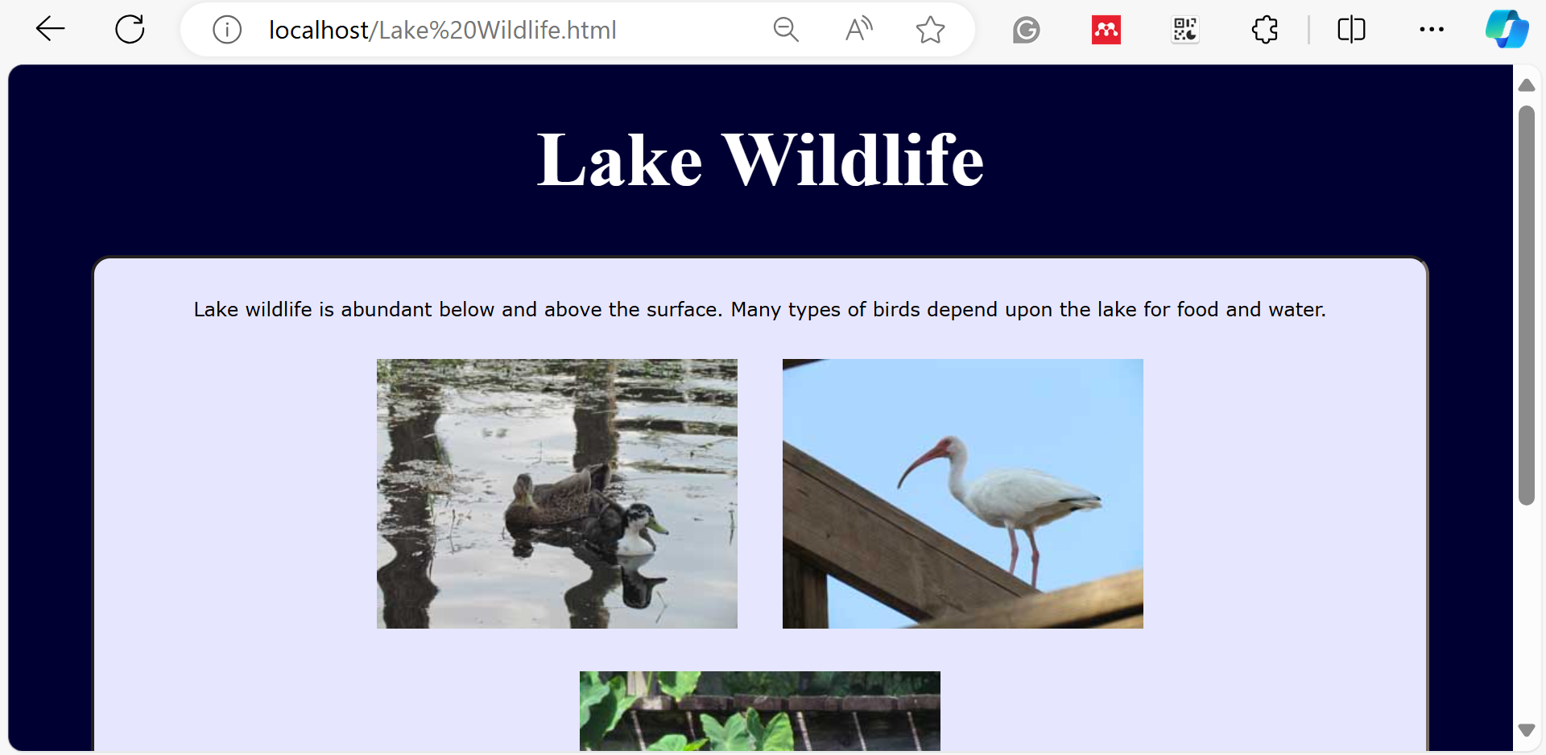
Instructions for Completing the Week 11 tutorial
Challenge 2: Improving SEO for a Webpage
Let's correct and enhance the provided analzyze11.html and analyze11styles.css files.
Corrected analyze11.html

Slide 17

Let’s Answer Your Questions
Live during class – Ask directly during sessions.
Blackboard Inbox – For structured academic queries.
Email – For formal communications or attachments.
Discussion Forum – Everyone can see and learn from your question.

Slide 18

Thank You
Happy Learning and Bright Futures Ahead!
Stay Connected: linkedin.com/in/farshid-keivanian github.com/FarshidKeivanian
Education is the most powerful weapon you can use to change the world. — Nelson Mandela

